Slide 1





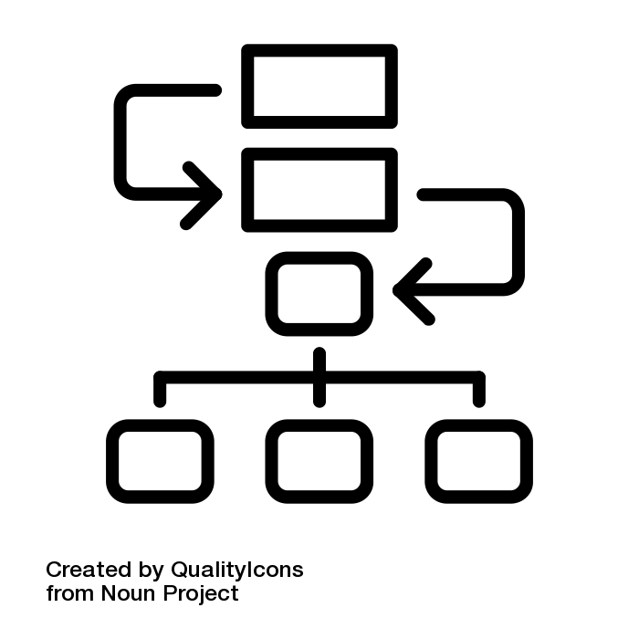






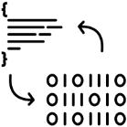




Computing Learning Journey
Subject Knowledge and Understanding with cross curricular skills
Subject Knowledge and Understanding
Subject Specific Skills
Bronze, Silver and Gold
G&T purple challenge
Planning an App with links
Adding buttons, sound and images
Develop an App to serve a purpose
Understanding Drama
Test a created App to ensure it is fit for purpose
Planning an App
Developing an App
Complete a working App
Spreadsheet terminology
Adding, subtracting, multiplying and dividing using cell references
Using functions to solve problems
App Development
Acting
Database files, records and fields.
Creating tables, forms and reports.
Creating Queries to search within a database
Skills
Spreadsheet uses and functions
Simple formulas
Advanced functions
Formatting queries to suit a particular audience
Database terminology
Using basic database tools
Advanced database tools
Use Absolute cell referencing and the Vlookup function
Spreadsheets
Databases
Data types
Variables
Selection
Iteration
Different python data types
Setting and recalling variables
Using Python selection statements in programs
Incorporate loops into a python program
Programming
Challenge
8
Python programming
Scratch programming
Converting binary to denary and denary to binary
Adding binary numbers
Completing logic gate truth tables
Planning and creating characters
Using the motion, event and control tools
Using operators and Variables
Planning in Scratch
Movement in Scratch
Shooting and Jumping
Binary Conversion
Binary Addition
Logic Gates
Create a scratch project with live scoring
Binary and Logic
Inside the Computer
Draw own logic gate and create truth tables
Explain how Fetch Decode Execute cycle works
Explain the importance of clock speed
Hardware, Input and output devices
Storage devices
The function of the CPU
Fetch Decode Execute cycle
Identify hardware, input and output devices
Explain the use of the devices
Explain the purpose of the CPU
Create basic Shapes
Use variables in a program
Use If statements to create a calculator program
Programming
Challenge
Introduction to Computer Science
7
Small Basic
Variables
Conditions and branching
Selection and Iteration
E-Safety
File Management and e-mails
Social networks
Threats to Data
Create a Subroutine menu for your Calculator?
Create folder Structures
What to do in different cyberbullying cases
How can you be private on Social networking sites?
Functions of Utility Software
Why is Censorship and surveillance important?

