Slide 1
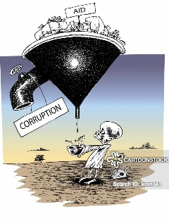



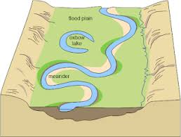

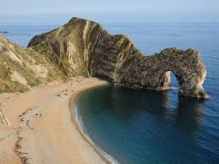

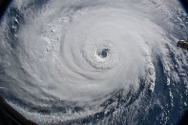


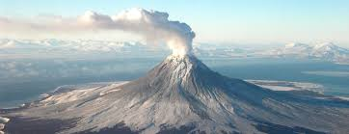


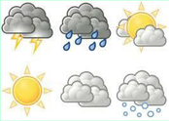

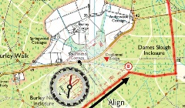



Virtues
Cross Curricular Links
Knowledge
Subject Specific Skills
Bronze, Silver and Gold
G&T purple challenge
Underlined = Deeper development of earlier skills / knowledge
Geography Learning Journey
Edmonton County School
Logo
Relational thinking
Question: Should the proposed development go ahead? Justify your decision
Unit 3: Geographical Applications – Part A: Issues Analysis
Perseverance
Collaboration
Perseverance
Collaboration
Progression to next stage of learning:
A Level Geography
Practise issues analysis
Addressing gaps / revision
Analysis of pre-release resources
Recall, identification, explanation, evaluation
Question: What are the economic development issues being faced? Paper 2 – world development issues, c/s of China (NEE) and UK economic changes
History – 20th century
Landscape interpretation; photo interpretation; OS map skills; explanation
Determination
Question: What resource inequalities exist, why and how? What are the issues and how are they managed?
Paper 2 study of food, water & energy in the UK + global water issues
Economic World
Question: How are river landscapes formed and managed?
Paper 2 – explores landforms, floods and flood management
Skills: Cartographic, numerical, statistical, GIS
Resource management
Geo-skills
Geo-skills
Fieldwork project & practise issues analysis
11
UK Physical Landscapes - rivers
Explaining changes & how management strategies work
Question: To what extent were the results and conclusions reliable? Students will investigate one physical (coastal) and one human (urban) fieldwork location and must answer questions based on stages of the enquiry process
Collaboration
Geo-skills
Question: What are the key issues and processes facing cities in LICs, NEEs and HICs? What opportunities & challenges do they face and how can these be managed sustainably? Explore issues facing a city in a NEE & a UK city
Opportunities, challenges & threats + mitigation
Skills: Cartographic, numerical, statistical, GIS
UK Physical Landscapes - coasts
Landscape interpretation; photo interpretation; OS map skills; explanation
Question: What is the nature and structure of hot deserts & TRFs?
Explaining changes & how management strategies work
10
Urban Issues
Science -
Food webs
Maths – rates of change
Question: How do natural processes form landscapes? What are the impacts of these processes, and attempts to manage them, on people & the environment?
Empathy
Reflection
Compassion
Living World
R&L - ethics
Explanation; evaluation
Question: What are the most important global environmental issues facing human society?
Exploring causes & consequences of climate change, biodiversity loss & pollution
Question: What are the biggest threats facing China?
Meltdown in Tibet: Students explore a range of threats facing Asia
Question: Which were the most important causes of the Morpeth floods?
Applying knowledge to a place and using relational thinking
Maths – graph interpretation
Relational thinking
Relational thinking
Developed reasoning; labelling
9
Natural hazards
Rivers & flooding
Global Issues
China
Evaluating
Explaining
Annotating
Annotation
Sequencing
Cause & effect
Empathy
Reflection
Compassion
Maths – rates of change; % difference
Natural hazards – distribution, processes, impacts & responses
Question: Which (of two storm c/s) was more significant?
Selecting salient points for comparison
Identify relevant factors
Explanation
Cause-effect sequencing
Application of process
Question: Why did the Holbeck Hall hotel fall into the sea?
Using sources and concepts to develop cause-effect logic
Science
Low pressure
Extreme Weather
Processes, landforms & management
History – Colonialism
Tectonic Hazards
Coastal environments
Tectonic hazards – distribution & processes
Decision-making
Explanation
Developed explanation
Detailed developed explanation
Relational thinking
Q: Which response to the Montserrat eruption is the best & why?
Using geographical evidence and relational thinking to show the implications of various scenarios
Investigation / research
Writing a structured, evidenced argument
English - Poetry
Photo analysis, selection, explanation
Development indicators
Factors influencing development
Population structure
BRICs
Push & pull factors
8
Maths – mean
Determination
Megacities
Cold Environments
Maths - Graph plotting
Question: Why did Sunil go to Kolkata?
Students will explore push and pull factors of migration applied to a real place. More able to make/explain connections
Evaluate from different perspectives
Water cycle stores & flows
Types of rainfall
Climate graphs
Weather & climate
Logical explanation
Sorting
Sequencing
Graph plotting & interpretation
Question: Should the ANWR be developed?
Resource-stimulus based topic; students put forward the case for/against
Question: Which is the most developed BRIC and why?
BRICs and development
Students to develop evidenced, persuasive writing (argument building)
Make / explain links
Characteristics, threats, impacts & management
Story-writing (DofE expedition around the Quiraing)
Nullify counter-arguments
Intro to Geography
7
Determination
OS Map skills & applied map skills
4 fig GR, direction
6 fig GR & distance, elevation / contours plotting cross sections (from contour maps)
Question: How are height, distance, features and locations represented on OS maps?
Students learn how to use 4 and 6 figure grid references, scale, distance, direction and contours
4 & 6 fig GR
Scale
Distance
Direction
Contours
UK vs. GB
London Boroughs
UK relief
Place characteristics, place description, use of adjectives & adverbs. geographical language
Maths - Coordinates
Question: What is geography?
Students examine Edmonton’s characteristics and how it is set within Enfield, London and the UK

