Slide 1


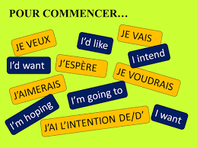



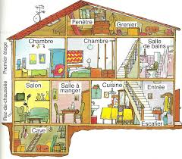





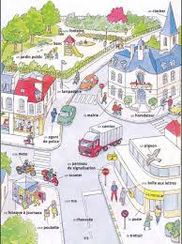




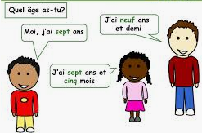
Content and Skills
A,G&T purple challenge
Broader skills
Extra Curricular
French Learning Journey
11
10
The near future tense and the simple future tense
Expressing wishes
Creativity
Reviewing skills needed for positive transition to GCSE
Secure and mastered use of 3 tenses
Independence
Reading and Listening skills
Recognise meaning
Infer meaning and draw conclusions
Read short stories, comics
Future Plans
Future Travels
9
Healthy Living
Using prepositions
Describe your home life
Chores and pocket money
Writing longer texts referring to 3 time frames
Reflexive verbs in the perfect tense
Visit to France
Cultural aspects: the capital, its landmarks and activities
3 time frames (verbs and phrases)
Creativity and independence in expression
Independent research
Visit to the Institut Français
Sustained Interest in Language learning
Foreign cultures
Confident manipulation of various structures and tenses
Home
Paris
Greater variety of verbs in the present tense
Expressing opinions with a wider variety of phrases
The present tense of 3 regular groups and some irregular verbs
The near future
Giving directions
Using a wider range of connectives and intensifiers
Retrieving more information from texts (audio and written)
Confidence in Writing
Reviewing and widening application: verbs in the present tense
The perfect tense
Leisure
Technology
Places in Town
Visit to France
Holiday
8
Independent Manipulation of structures
Free Time
Retention of knowledge
Translating short paragraphs
(French- English and English-French)
Using the near future tense
Manipulating verbs in the present in all 6 forms
Using verbs in 2 tenses
Systematic use of key phrases to extend answers
Greater range of adjectives and intensifiers to justify opinions
Writing longer texts
Building Resilience
At school
Introducing myself
7
My family
Confidence in Speaking
Engagement
Full conjugation of auxiliary verbs
Adjectives to describe oneself and others
Expressing likes/dislikes
Giving reasons
Longer and more detailed conversations from memory
Using transferrable skills
Understand basic syntax
Techniques to facilitate vocabulary acquisition
Negative structure
Grammar concepts: gender/plural agreement (articles, nouns, adjectives) and conjugation of high frequency verbs/auxiliaries
Asking and answering simple questions

