Slide 1



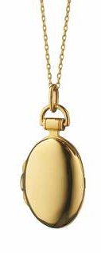



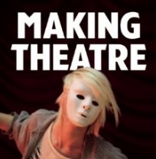

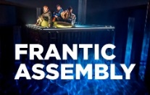
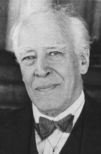

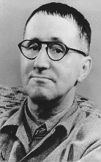

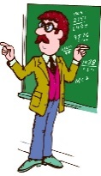

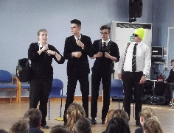
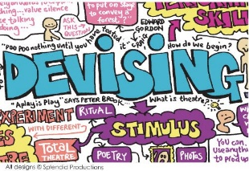

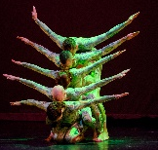
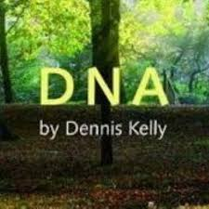


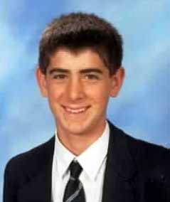
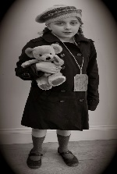
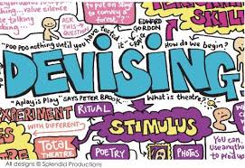
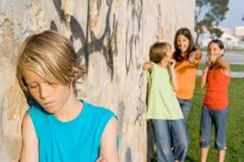
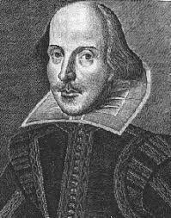
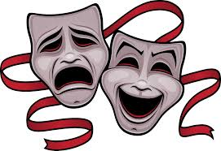
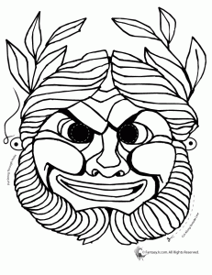

Virtues
Cross Curricular Links
Knowledge
Subject Specific Skills
Bronze, Silver and Gold
G&T purple challenge
Underlined = Deeper development of earlier skills / knowledge
Drama Learning Journey
Edmonton County School
Logo
Completed Comp 1 Written exam
Completed external examiners visit Comp 3
Question: Is it important to stay true to a playwright’s intention?
Component 1 - Understanding Drama - Study of set text Blood Brothers.
4MQ 8MQ 12MQ 20MQ 32MQ
Progression to next stage of learning:
A Level Drama & Theatre
BTEC Performing Arts
Performing Arts Colleges eg CAPA / MADD
Understanding Drama
Texts in
Practice
Attentiveness
Self control
Reflection
Confidence
Playwright intentions, deconstructing text, Willy Russell, Social & Historical context
Set & Staging
Costume
Lighting
Sound
Question: How can you communicate effectively to an audience? Component 3 – study of plays for monologues and group work Directors opportunity
Emotion memory
Given circumstances
Magic If
Science
Breathing
Y8
Question: Whose style is it anyway?
Component 2 intro to devising – workshop practitioner’s style
DIRECTORS OPPORTUNITY
Proxemics
Staging
Narration
Mime
Lighting
Sound
Honesty
Kindness
Forgiveness
Question: What role does symbolism play in foreshadowing events in Blood Brothers?
Component 1 Study of Text
Understanding
Drama
Devising
Drama
11
Completed comp 2 Devised and Sections 1-3
Style &
Genre
THEATRE TRIP
Courage
Curiosity
Respect
Play
Brecht, Stanislavski,
Berkoff, Artuad,
Frantic Assembly, Kneehigh
Trust, confidence,
self control
Question: What makes good theatre?
Students will explore a range of stimuli & use their knowledge of performance styles, genre & form to devise a piece of theatre Reflect
their approach in an excellent section 1 Component 2
Science
Breathing
Y8
Direct Address
Narration, Multi Role
Question: What type theatre is more powerful, naturalistic or non-naturalistic? Explore a range of performance styles including
Brecht, Stanislavski, Artuad, Berkoff
Question: Does
Nature or Nurture have the biggest impact in life?
Text
Exploration
Acting
Willy Russell
Brecht
Musical tragedy,
10
Performance
Styles
Skills
Question: Theatre should connect to people’s lives not be a piece of candy floss. Agree or Disagree? Component 3 Intro to performance using Blood Brothers
Confidence,
Play
Sense of humour
THEATRE TRIP
History - Weimar & Nazi Germany
Nature V Nurture
Compassion
Empathy
Family
Narration, Flashback, Mime, Crosscutting
Emotion memory
Given circumstances
BLOOD BROTHERS
Question: Can drama help us be healthy?
Theatre in Education – explore the effects of Mental Health and how to educate a Year 6 audience on the signs and how to get help
Performance to year 6 opportunity
Reflection
Deliberation
Respect
Question: What makes good theatre?
Students will explore a range of stimuli & use
their knowledge of drama conventions & performance styles to devise a piece of
theatre
Reflection
Kindness
Hope
PSHE
Mental Health Y8
Theatre
in Education
Narration, Flashback, Crosscutting, Monologues
9
Question: How can we use symbolism & metaphors in performance?
Developing
Ensemble
skills to
create
abstract
drama
Ensemble
Characterisation
Performance Styles
Learn lines
Devising
THEATRE TRIP
Characterisation
Vocal Skills
Physical Skills
Staging
Space
Movement
Physical
Art - Composition Artists Y9
Physical
Theatre
Solidarity
Compassion
Love
Forgiveness
Question: What makes a character interesting for an audience?
Commedia and Pantomime
Students to develop their physical comedy skills over a series of teacher led workshops, including the art of slapstick to re-tell a fairy tale as a pantomime
Music
Just Play Y7
Question: What happened to Adam?
Exploring plot, character,
language & structure of modern Tragedy
Performance style, stock characters
History – 19th Century Britain
Trust, confidence,
self control
DNA
Pantomime
Question: Should drama help to retell the past?
Using historical facts to develop empathy, leading to a performance using the conventions to show the journey and life of an Evacuee
G&T yr8
Masterclass
Workshop
Love of learning
Sense of humour
Play
Confidence
Dan
Nolan
Written monologue
Learned monologue
Learned and performed
Directors opportunity
Narration, Flashback
Crosscutting, Tableau
History – WW2 – Y8
Documentary drama
Verbatim theatre
Determination
Compassion
Integrity
Trust
Documentary Drama
Tableau, TT, Narration, Flashback
8
Evacuees
Devising
Hope
Bravery
Friendship
Forgiveness
R&L belonging
PHSE Prejudice
G&T Yr7
LGBT
Assemblies
Question: Where can we turn?
Students will explore the life of ‘Sam’ and how he deals with Bullying
Question: How important is performance to cultural identity?
Stimulus based topic
Narration
Question: Should drama educate or entertain?
Exploring the true story of the disappearance of Dan Nolan – students explore the range of drama conventions & style of Verbatim Theatre
Bullying
Drama conventions
Ensemble performance
G&T Yr7
Theatre
Trip
Explorative strategies
Hot seating, mind-map, Role on wall Directors opportunity
Solidarity
Compassion
Respect
Kindness
Patience
Forgiveness
Intro to Drama
7
Shakespeare
Question: Is Shakespeare relevant to today's society?
Hamlet and Romeo and Juliet
Students will explore plot, character,
language, structure, Iambic Pentameter
Genre
Style
Determination
Compassion
Integrity
Trust
Love
Frozen Image
Thought track
Practical, Group input, Verbal evaluation. Drama Language
English
History
Narration
Flashback
Cross-cutting
Tableau
Question: How do we communicate to an audience?
students develop their physical and vocal skills by exploring the basic techniques of Drama
Confidence, resilience

