Slide 1
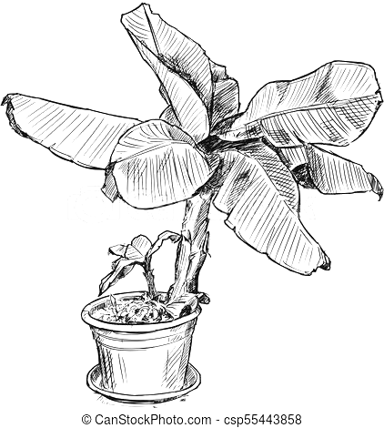
Virtues
Cross Curricular Links
Knowledge
Subject Specific Skills
Bronze, Silver and Gold
G&T purple challenge
Underlined = Deeper development of earlier skills / knowledge
ART Learning Journey
Edmonton County School
Logo
11
10
Question: What careers are there in art / photography? Students complete a HW research art/photography careers in preparation for GCSE options.
List of careers, career poster, compare/contrast careers, high level of presentation/research
Drawing, cautting accurately, stencil cutting
Question: What is Graffiti, and is is art? Students explore graffiti, street art, its relevance and techniques.
Art / Photography careers
Forward planning
Aspiration
Graffiti
Street Art
Artists
Typography
Creativity
Imagination
Appreciation
Photomontage,
collage, drawing, painting, batik,
Using artists
as inspiration
Using scissors
Careers in
Art / Photography
Graffiti
9
Drawing, cutting with accuracy, creative/imaginative outcomes, links to political themes/statements
DT
History
Block lettering, stencil cutting, illustration, message/statement
Creativity
Imagination
Risk Taking
History
Media
Photography
Drawing, Colour Theory,
Composition, Using artists as inspiration
Question: What is Pop Art and why was it important? Students create artworks in the style of Pop Artists – Warhol, Lichtenstein, Opie, etc.
Working in exam conditions, observational drawing, tone/shading, composition
Line drawing/outline, colour, tone, light and shadow, scale/proportion, composition, using imagination and creativity
Surreal Artists, Surrealism, Political, surrealist
Illustration
Surrealism
Pop Art
Question: What is Surrealism
and why was it important? Students explore surrealism through a range of artists and techniques.
Pop Artists
Pop Art
Cartoon like drawings, ben day dots, colour, creative composition
Question: How confident and able are we as artists? Pt1. Assess students artistic skills and through tonal observational drawing of bottles. Pt2. Create a second abstract version, using colour.
Yr 8 Intro Exam
English – ISBL HW
Question: How are masks used throughout the history of the world, and in different cultures?
Students create a mod roc mask on a given theme
Masks
Theme specific knowledge (ocean conservation / Gargoyles)
Colour Theory
Drawing, Colour Theory, Composition, Using artists as inspiration
D&T
Photography
Creativity
Confidence
Creativity
Consideration
Michael Craig Martin
8
PSHE / R&L – different cultures
History – gargoyles
Science – Ocean Conservation
English - ISBL
English – HW research abstract artists
Masks
Mask covered evenly with mod roc, adding 3D elements, refining design/finish, painting with precision and skill
Question: How can we create interesting compositions?
Students create a composition in the style of Michael Craig Martin
Michael Craig Martin, Photoshop
Line drawing/outline, overlapping composition, colour, digital version
Homework – research abstract artists
Risk taking, Confidence, Resilience, Persistence, Respect, Patience
Drawing, Modroc, Colour mixing, Painting 3D objects
Confidence, Risk Taking
Yr 7 Intro Exam /
Baseline Assessment
7
Minimal ability / basic, some ability / some detail, consistent ability / detailed, developed ability / refined
Formal Elements
Formal Elements
Of Art – colour, tone, line, composition, shape, texture
Drawing
Painting
Shading
Using art equipment
Question: What are the formal elements of art? Students will explore line, tone, crosshatching, shape, form, proportion, composition, movement, colour theory, colour mixing, pattern, etc.
D&T
PSHE / R&L – disabled artists
Working in exam conditions in the art room
Line drawing/outline, tone, scale/proportion, texture
Question: How confident and able are we as artists?
Assess students artistic skills and through tonal observational drawings of plants

