Slide 1

Inspiring a lifetime of adventure

Slide 2
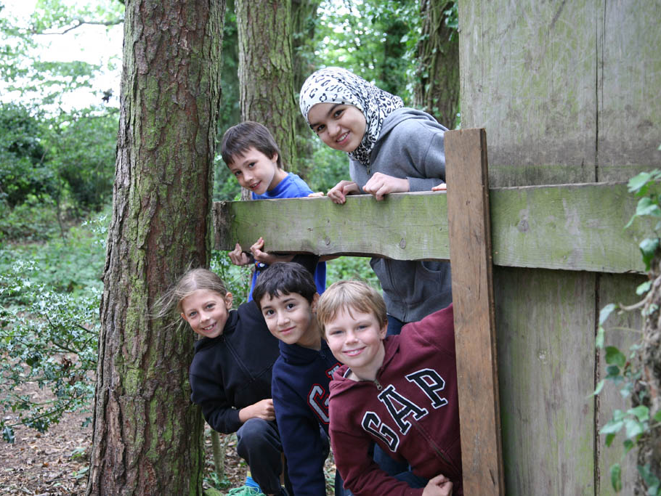
Wildchild Residential Adventure
Edmonton County
Wednesday 3rd – Friday 5th June 2020

Slide 3
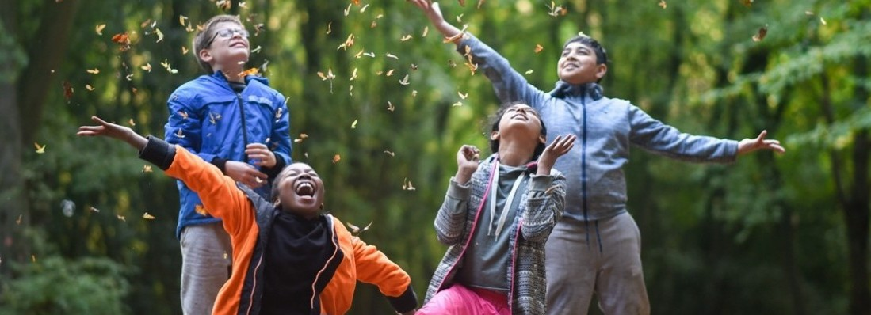

Where the adventure happens…
Phasels Wood Activity Centre is a Scout Centre situated in natural woodlands in Hertfordshire, with an extensive choice of Outdoor Adventure Activities

Slide 4
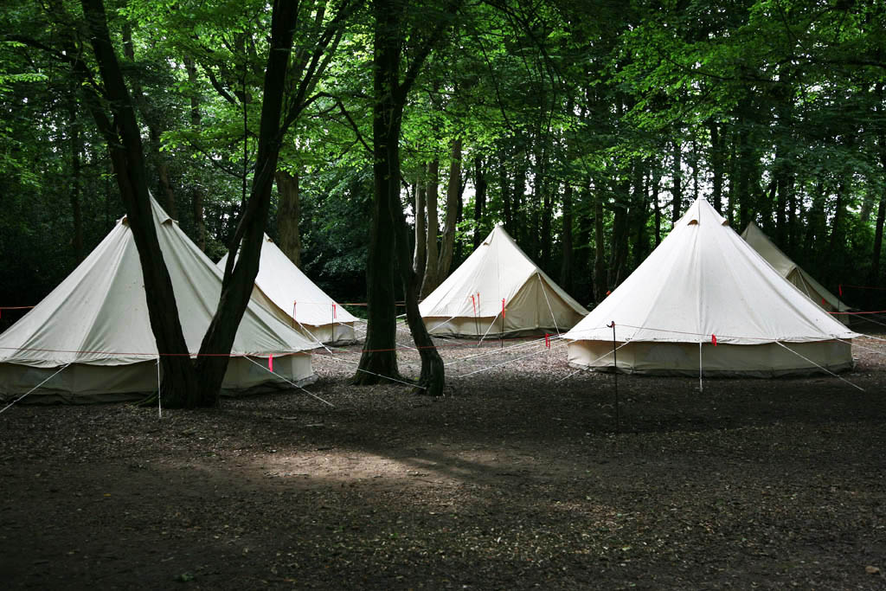
Sleeping under canvas in our traditional bell-tents
Notes:
Wildchild’s bell-tented village provides accommodation and somewhere to unwind and relax during children’s well-deserved downtime.
The tents are set up with separate male and female sleeping areas, and teachers’ tents situated among children’s tents.
There is a separate toilet / shower block for children to use during the day, and night time toilets are available on the campsite. There is a motion-sensored lighting system on the camp which operates at night-time.

Slide 5
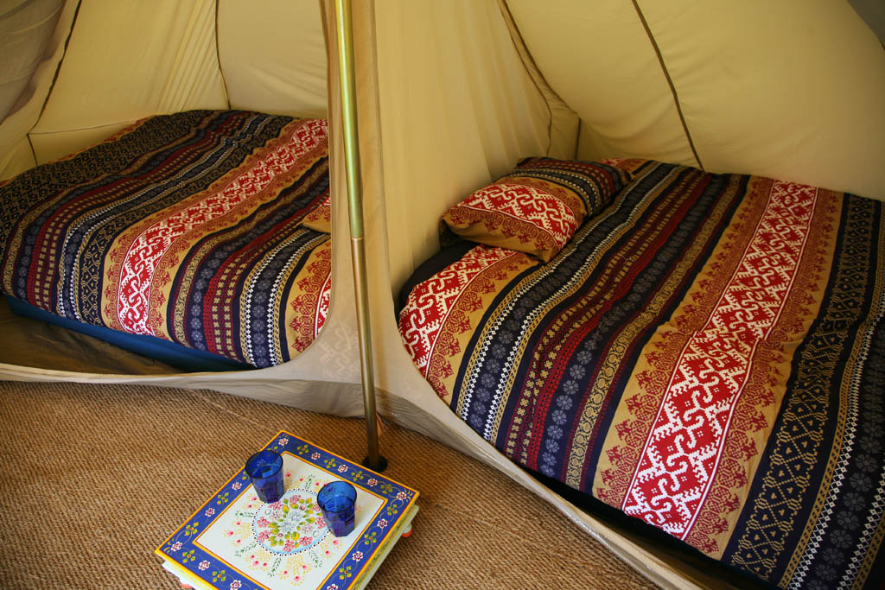
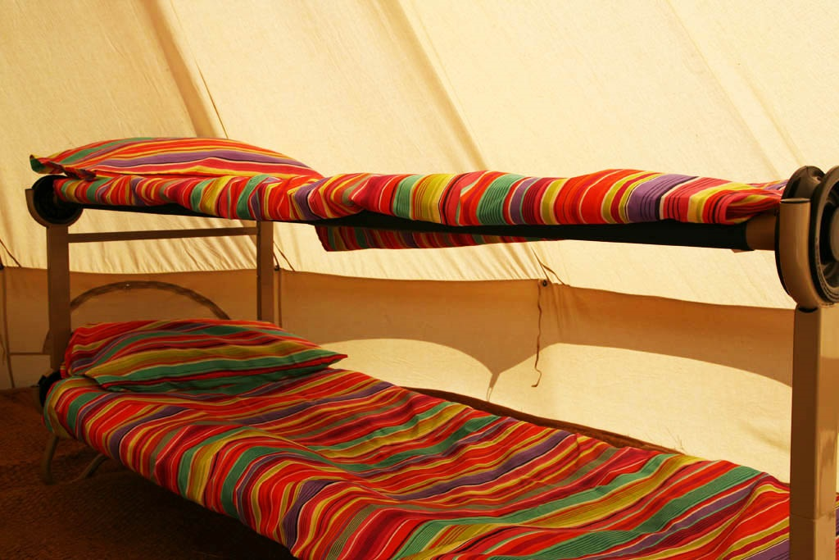
Spacious and comfortable accommodation for pupils and teachers
Notes:
Children’s tents sleep 6 on 3 bunk beds.
Teachers will allocate children to (single sex) tents in advance of the trip.
Teacher tents sleep 2 in separate, partitioned sleeping areas on double inflatable mattresses.
Children and teachers will need to bring their own bedding and pillow.
We strongly advise all season sleeping bags even in the summer, as it can feel cold at night. Or plenty of warm layers / extra blanket.

Slide 6
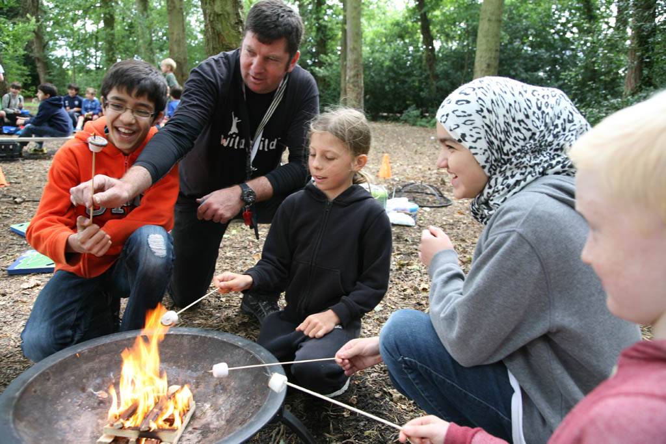
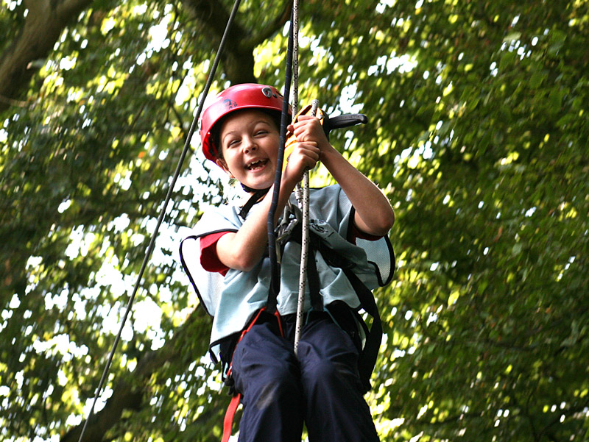
Exciting Outdoor Adventure Activities
Wild Survivor Bushcraft (Shelter building/Fire-lighting/Survival skills/Camp-fire cooking)
Team-building activities
Outdoor adventurous activities, including high-ropes and zipwire.
Evening Games and Toboggans
Camp-fire supper, songs and reflection time.
Notes:
At Wildchild our aim is to help children discover the joy of the great outdoors. Our focus is on providing high quality outdoor experiences that help children to engage with nature, encourage exploration, teamwork and creativity.
We work with schools to develop an itinerary that offers a combination of outdoor adventure activities and bushcraft, survival skills building sessions.
Activities are accessible for all children, and rather than pushing children to go highest or fastest, we encourage perseverance, self-motivation and the willingness to set new goals and test their own limits.
Wilchild instructors are fully trained, DBS checked and hold qualifications in all the relevant activities they teach.
Children will be split into groups for most of the activities.
There will be a Wildchild instructor and a teacher with every activity group.
In the evening, we enjoy group time around the campfire playing games, reflecting on the day and sharing stories.
Children and teachers are welcome to prepare songs, bring instruments for musical performances or prepare entertainment for this time around the campfire.

Slide 7
EXAMPLE ACTIVITY PROGRAMME - DAY 1
Day 1
Time | Activity | Group | Meals
10:00 | Arrival/Camp welcome | All
11:00-12:30 | Scavenger hunt/Bug Shelters | All
12:30 – 1:30 | Lunch/Free time | All | Packed Lunch (children to bring)
2:00-5:00 | Wild Survivor Bushcraft | Group 3/4
2:00 – 3:00 | High Ropes/Zipwire | Group 1/2
3:00-4:00 | Team-building | Group 1/2
4:00-5:00 | Zipwire/High Ropes | Group 1/2
5:30-6:30 | Dinner | All | Roast of the day, potatoes and vegetables, apple crumble and custard
7:00-8:00 | Evening Games/Tobogganing | All
8:00-8:30 | Campfire/Supper | All | Hot chocolate, cake/fresh fruit
Notes:
This is an example of what your child could expect on the first day of their Wildchild Adventure.
On arrival, children will walk from the coach drop-off point to the campsite. Please ensure as much as possible that they bring all luggage in a large rucksack and avoid cases with wheels (due to the rough terrain) or bags that are difficult to carry.
After a brief welcome session, children will be shown to their tents where they will have time to unpack their sleeping bag ready for the evening if they’d like to, and spend some time getting to know their tentmates.
The first activity will generally be along the lines of scavenger hunting and building bug shelters, as a way to get to know the new natural environment that will be their home for the duration of the trip.
Over the course of the day and in their groups, children can expect to take part in five or six different activities, usually a combination of outdoor adventures such as abseiling, archery and climbing, teambuilding games and bushcraft sessions.
We also have evening activities to enjoy after dinner and before the downtime the campfire.

Slide 8


Meals
Example Menu
Breakfast
Cereal, toast, yoghurt, fruit juice, egg and beans.
Lunch
Baked potato, cheese and salad.
Fresh fruit
Dinner
Roast Chicken, potatoes and veg. Chocolate sponge and custard
Supper
Hot chocolate and biscuits
Notes:
Meals are freshly prepared on site by Phasels catering staff.
This is a sample of what children can expect.
As much as possible meals will include a balance of fruit and vegetables, carbohydrates and protein, to give children the energy they need for the day.
Other than packed lunch for Day 1, we ask that children do not bring additional snacks. To avoid attracting the local squirrels, we have a ‘no food in tents’ policy.

Slide 9
Kit List
Sleeping bag/travel pillow (essential)
Large rucksack/holdall containing all kit list items except sleeping bag
Several sets of clothing to include:
Track suit/hard-wearing trousers/shorts (jeans not recommended)
Base layers/vests
T-shirts
Warm fleece/jumpers
Socks/underwear
Waterproof jacket (essential)/Waterproof trousers
Warm clothes to sleep in (please remember even in the summer camping can be cold at night, so layers essential)
Sturdy shoes or boots
Trainers (not plimsolls)
Named water bottle
Insect repellent/Sun cream
Sun hat or warm hat/gloves depending on weather
Toiletries including toothpaste, toothbrush, roll-on deodorant (not aerosol). All preferably in a named wash-bag.
Towel
Torch/spare batteries/
Plastic bag for dirty clothes (black-bin liner)
Notes:
This is a list of the key items children should bring with them. A detailed kit list is available on the Wildchild website.
Very important to stress that any clothes / shoes the children bring with them you should be prepared to get dirty.
Plenty of layers. Comfortable clothing like tshirts, sweatshirts, hoodies, waterproof jackets are a must.
The ground is likely to be muddy even in summer so sturdy walking boots / wellies are ideal, as well as old trainers.
There are water taps available throughout the site for children to fill up their bottle to ensure they stay hydrated, so please make sure they do have a bottle with them.
No valuables / electronic items please.

Slide 10
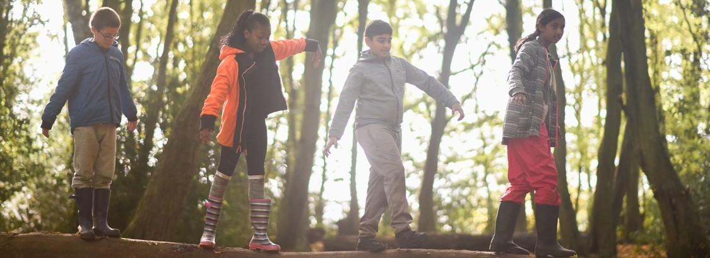

Inspiring a lifetime of adventure
https://vimeo.com/224365018
For more information and to download your parent guide and kit list visit www.wildchildadventure.com

